Slide 1
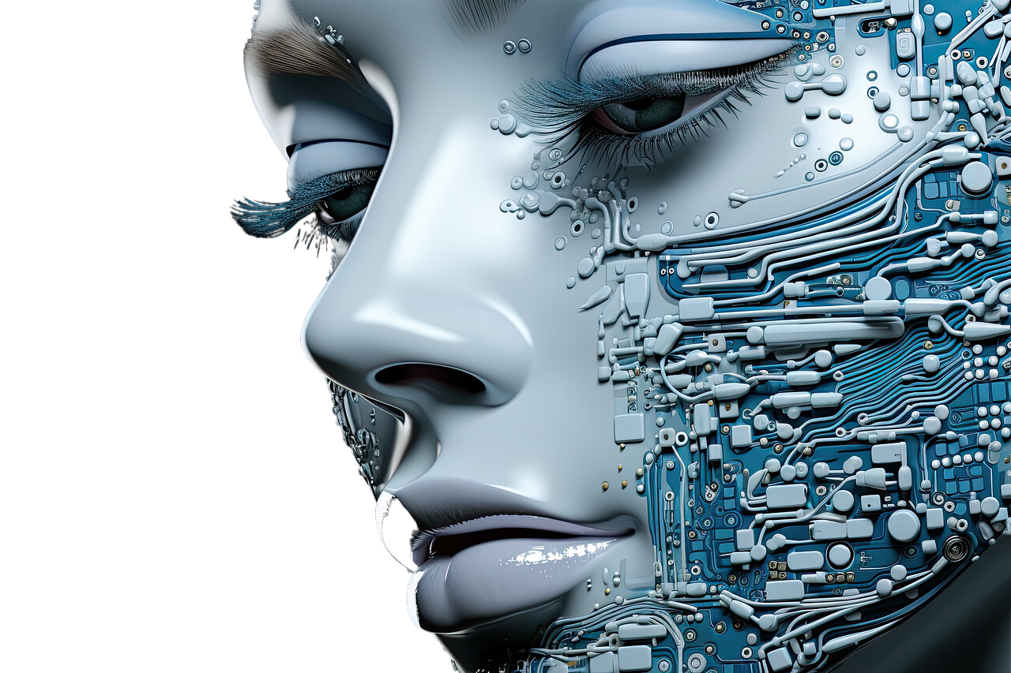



LLM – DETECT AI GENERATED TEXT
CRISTIAN CIRIACO CAMPAGNA 242604
GIOVANNI IANNUZZI 214900
PIERPAOLO SESTITO 242707

Slide 2

Overview
Problem description
The goal
Distinguish between human-generated and language model generated text.
The Kaggle Competition, "LLM Detect AI Generated Text" provides us an opportunity to explore and address this task.
Construct a machine learning model that excels in classifying text as either human-authored (labeled with 0) or generated by a language model (labeled with 1).

Slide 3



Dataset description
train_essays.csv
train_prompt.csv
ID | A unique identifier for each essay
prompt_id | Identifies the prompt the essay was written in response to.
text | The essay text itself
generated | Whether the essay was written by a student (0) or generated by a LSSM (1).
prompt_id | A unique identifier for each prompt
prompt_name | The title of the prompt.
instructions | The instructions given to students.
source_text | The text of the article(s) the essays were written in response to.

Slide 4

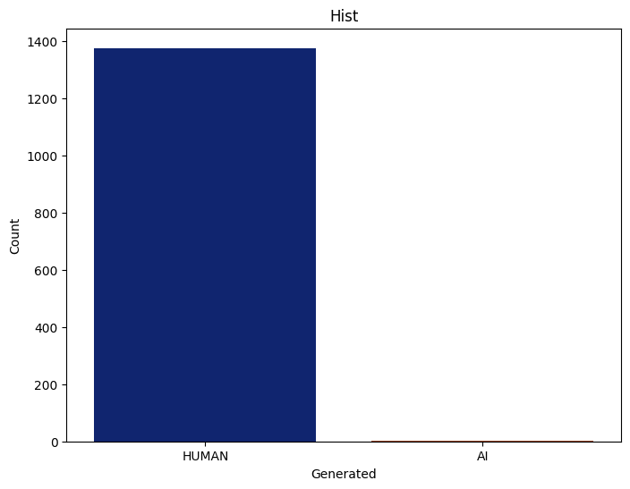
MANDATORY PAGE
TRAIN_ESSAYS.CSV
CLASS IMBALANCE
1375 labeled as 0
3 labeled as 1

Slide 5
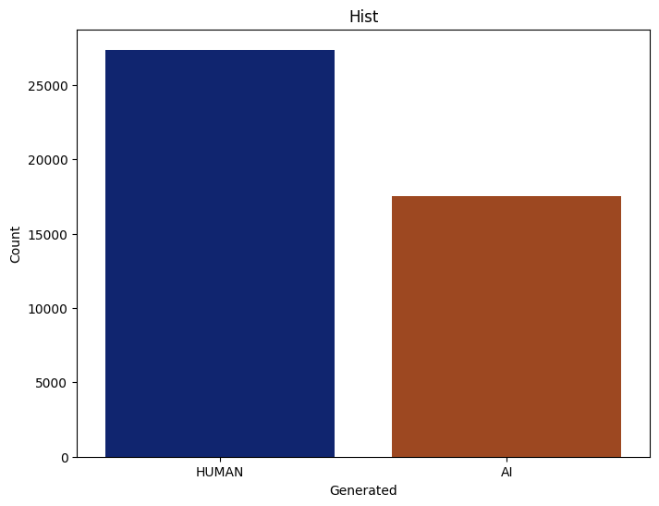
MANDATORY PAGE
DAIGT-V2
DATASET PROVIDED BY THE KAGGLE COMMUNITY
27371 labeled as 0
17497 labeled as 1
More equitable distribution but not at all!

Slide 6

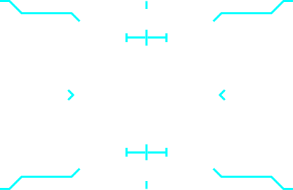


MANDATORY PAGE
Extended dataset
1
2
Cosine similarity
Record generation
Calculated for pairs of textual records attributed to human authors.
Entries with similarity >= 0.9 were pruned to reduce redundancy.
Introducing new record to decrease the unbalance.
Cohere and Mistral-7b-v0.1 as generative models for text-generation.

Slide 7
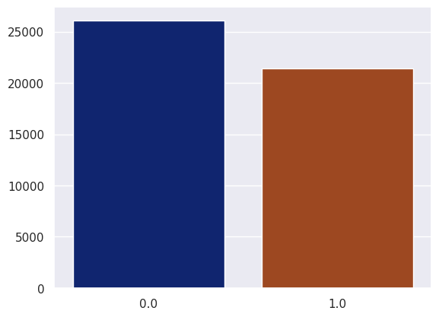
MANDATORY PAGE
DAIGT-V3
OUR NEW EXTENDED DATASET
26105 labeled as 0
21397 labeled as 1

Slide 8




Preprocessing
Irrelevant columns
Removal
Stop word removal
Lowercase Conversion
Other attempts
Removed commonly occurring words that contribute little semantic value to the text.
All sentences were converted to lowercase.
To standardize text and reduce dataset’s dimensionality.
Strip punctuation and lemmatization.
During the training phase they were removed as they achieved poor results.
(prompt_name, source, RDizzl3_seven, id)

Slide 9


Attempted architecture
Final architecture
BERT-model
Recurrent Neural Network variant
Why yes:
Renowned for its contextual language understanding.
Promising candidate for our task.
Why not:
512-token limit
Faced with the challenges posed by pre-trained models, we turned our
attention to building a custom solution.
Why yes:
Well-suited for sequential data and exhibit the ability to capture dependencies over time. This approach offers more flexibility in handling datasets with varying lengths of text sequences
LongFormer model
Why yes:
It exceed the BERT model token limit, offering a max range of 4096 token.
Why not:
Computational resource saturation

Slide 10
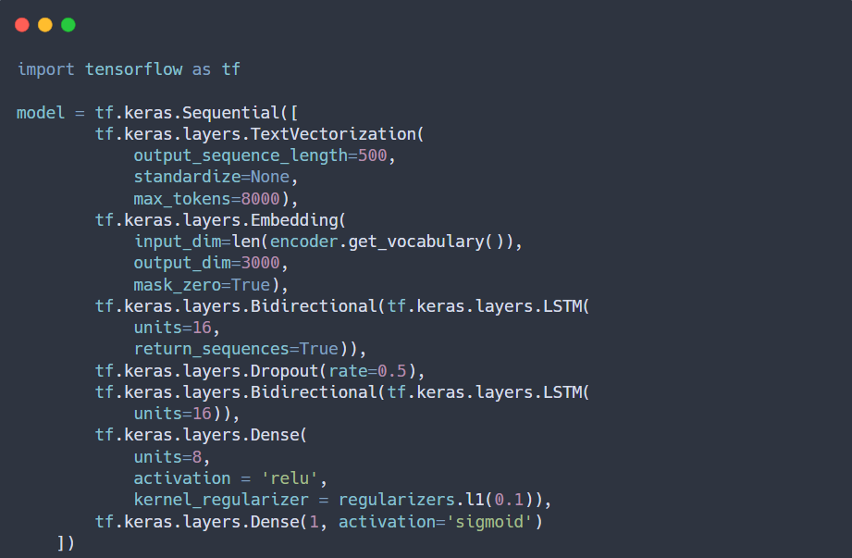
Final Model - Code

Slide 11
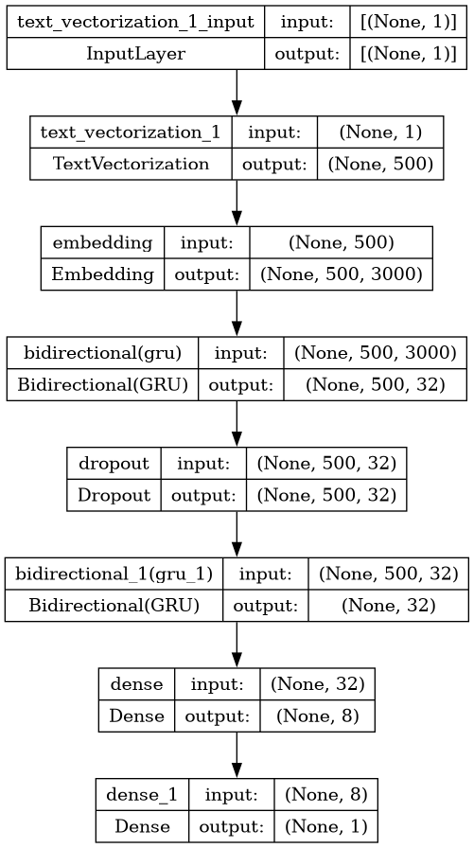
Final Model - Visual representation and description
Text Vectorization Layer:
Tokenizes and vectorizes the input text.
Maps text into token sequences (appropriately applying truncation/padding techniques)
Embedding Layer
Converts generated tokens into dense vectors.
Basically each token is represented by a long-vector.
1st Bidirectional LSTM
Returns the complete sequences instead of just the final output for each sequence.
It will provide an output of each time step in the input sequence
Dropout Layer
2nd Bidirectional LSTM.
Does not return the complete sequences, but the final outputs.
Dense Layer with ReLu Activation Function with L1 Regularization.
Adds a term to the loss function - It has property of making many weights of the model exactly to zero.
Prevents overfitting and improve model generalization
Output Layer

Slide 12
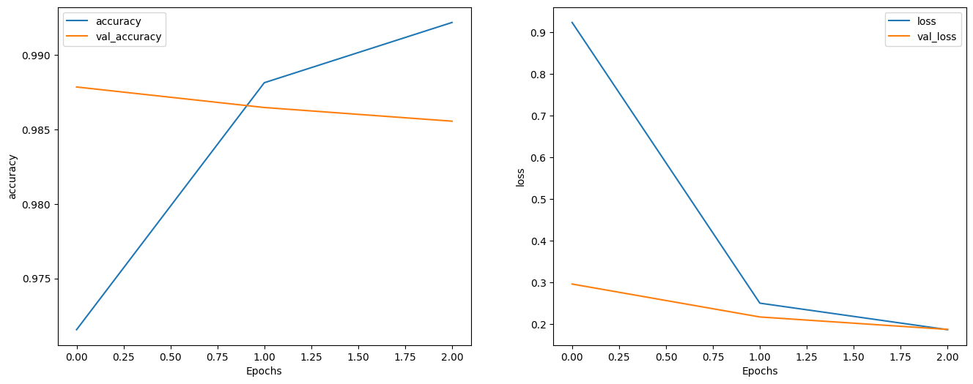
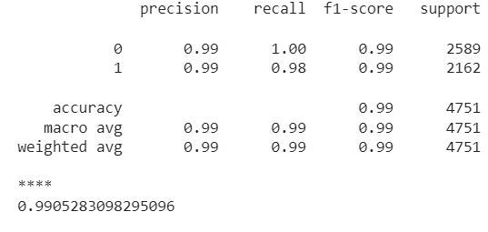

Evaluation

Slide 13
Final considerations
Problem: In the light of the results obtained, some considerations emerged on how the various technologies and resources obtained during the work could be used, in order to obtain a more larger, consistent, balanced and general dataset.
Possible solutions:
Use the found models for the text generation to generate a number of different prompts (~1000) and then use the same models to generate a number of records (~100) labeled with 1 (AI). After several considerations, we realized that we could use some generative models (pre-trained on datasets containing only texts written by humans) to generate the remaining records (~100), for each prompt, labeled with 0 (Human).
Generate more AI records with other generative models to balance at all (maybe with others models that respect our computational resources limitation).

Slide 14

Our results:

Slide 15
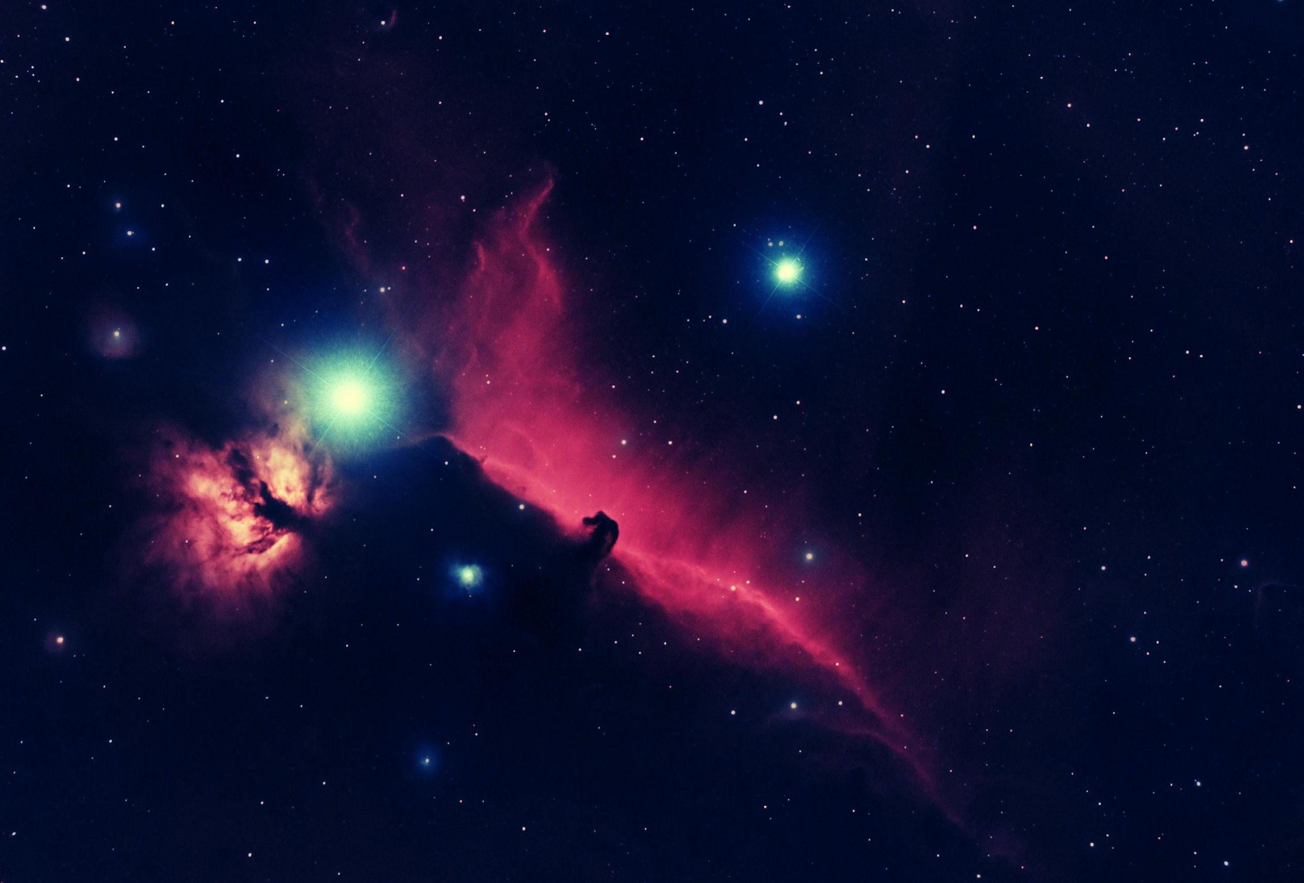

Thanks for your attention!
GItHub Repository

